Slide 1
G.K.BHARAD INSTITUE OF ENGINEERING DIVISION:D (C.E.) Roll Number :67 SUBJECT :CS SUBJECT CODE:2110002
Ch-4 Reading Fluency
Presentation By:
Kartavya Parmar
Guided By:
Lect. Rahul Chav

Slide 2
Improving your comprehension skill
Analyze the time and space in which you are reading. If you have been reading or studying for several hours then mental fatigue may be the source of the problem. If there is a lot of disturbance in surrounding , you may not be able to read for understood what you are reading .
Rephrase each and every paragraph in your own.
Read a loud sentences per section that are partially difficult .
Slow down your reading speed.
Write a brief outline of major points.
High-light key words.
Writes a notes in the margin.
Read a verity of text and materials. Don’t limit your self to a text book on a ice
Consider how much you already know about the subject.

Slide 3
1)Skimming 2)Scanning
Skimming
Skimming is a immediately recognize the main idea of a text. When you read the newspaper you are probably not reading it’s word by word skimming is a done at a speed for time faster then the normal reading.
People often skim when they have to read a lot of materials in a limited time period used skimming. When you want to see if any article and this article some people read. Heading , title and subtitle or illustration this technique is useful. When you look for specific information rather then reading for understanding.
Scanning
scanning means moving your eyes quickly down the page finding specific words and phrases.
Scanning is the technique you often use when you are looking up a word n the telephone directory or dictionary you search for key words , you know what you are looking for, so you are concentrating or finding a particular word or answer.

Slide 4
Explain The Purpose Of Reading
Reading is one of the most important academic task faced by students. It is equally important in the business world. You may have to read a variety of text starting from short e-mails , to a bulky book or lengthy reports everyday.
When we have to read an entire book in o ne hour we mostly scan the words or sentences that are important. “The purpose of reading is to connect the ideas on the page”.
For example,
751-2634 This is beat hard to read and remember.
751-26-34 This is comparatively easy to read and remember.
1234567 This is easiest to read and remember because of prior
knowledge and structure.
Similarly if you like history, it will be easy to understand some writers or some historical statements because you have a frame worke in your mind for a reading and understanding.

Slide 5
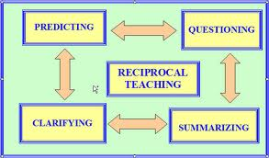
Discuses reading strategies/speedreading tips.
Your purpose in skimming or speed reading is to get an over all information of the contain in the reading selection. Below is step procedure for speed reading.
Look for the titles, subtitles or headings or subheadings .
Read the introduction.
Pick out the topic sentences.
Notice any picture, charts,graphs, etc.
Try to guess the meaning of some words as per the sentences .
Glance at the remainder of the paragraph.
Take notes or high-lights the main points when you read.

Slide 6
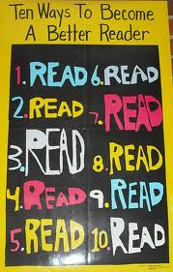

Slide 7
Thank you for giving your attention

